Slide 1
Tutorial-7

Slide 2
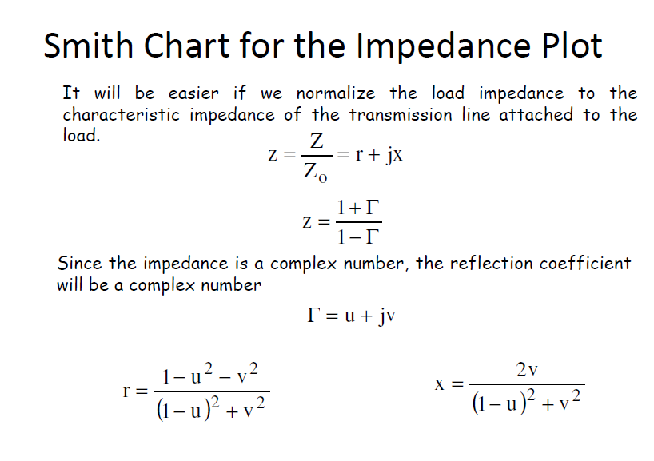

Slide 3
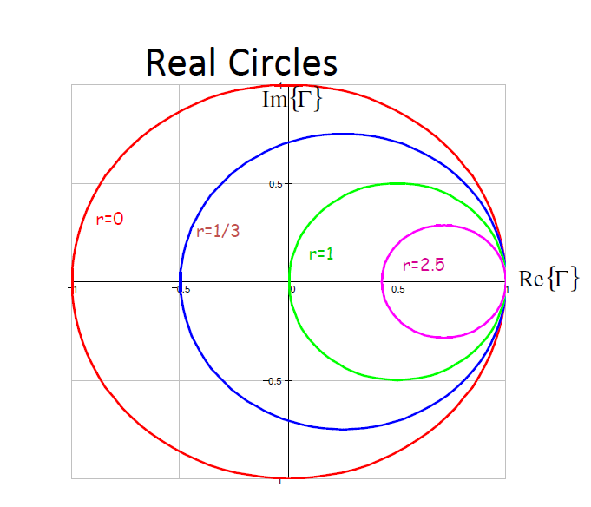

Slide 4
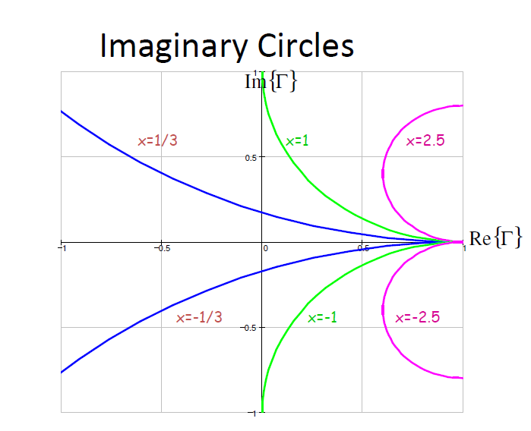

Slide 5
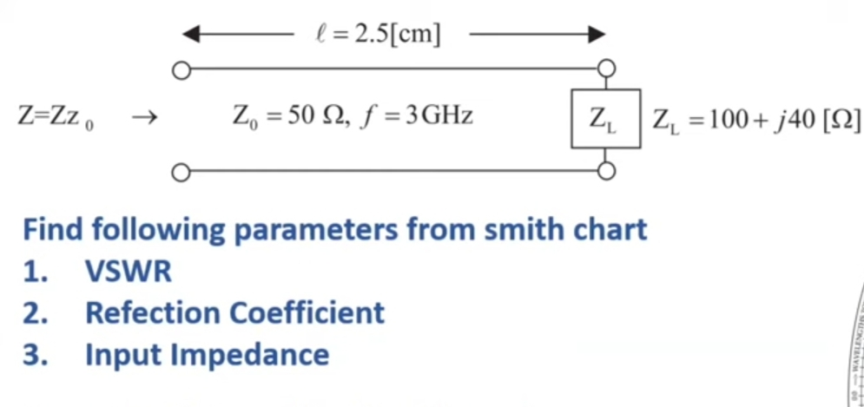

Slide 6
A 75Ω transmission line is terminated by a load impedance Z_{L}. If the line is 6ƛ/8 long. Calculate Z_{in} when Z_{L} = 25 + j 65 Ω

Slide 7
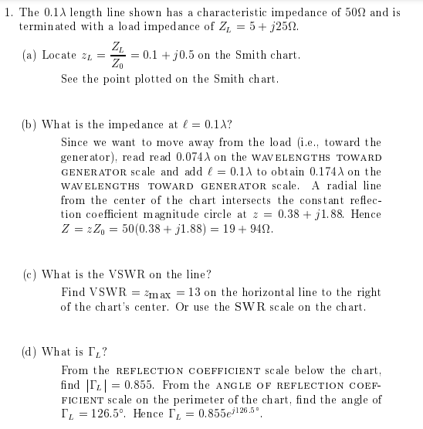
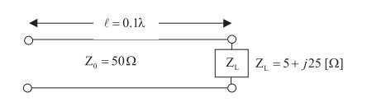
Find the following parameters using smith chart:
1). VSWR
2). Reflection Coefficient in polar and Cartesian form
3). Zin at l = 0.1ƛ

Slide 8
